Slide 1


Doctor Appointment System

Slide 2


Team Members
SHUBHAM SHARMA
NARESH
KIRAN
ROHIT
YASHI
MANEESHA

Slide 3


GUIDED BY
MR. BALAKRISHNA PALLA

Slide 4



PROJECT INTRODUCTION
The Doctor Appointment System is a web application that gives a solution to the polyclinic patients.
This system manages complete appointment details in a single application and in a single database.
The users will use this system to handle all the functionalities easily.
The intention of the system is to reduce overtime pay and increase the number of patients that can be treated accurately.

Slide 5



OBJECTIVE
-> To provide a convenient way of appointment reservation for patients.
-> To computerized the patient’s information review and maintenance.
-> To give clinic staffs an easy way in doing information maintenance and updates.

Slide 6

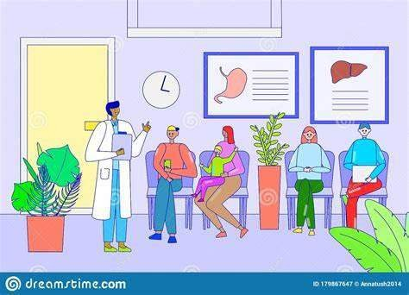


PROBLEM STATEMENT

Slide 7



LIST OF MODULES
Admin
Doctor
Patient

Slide 8
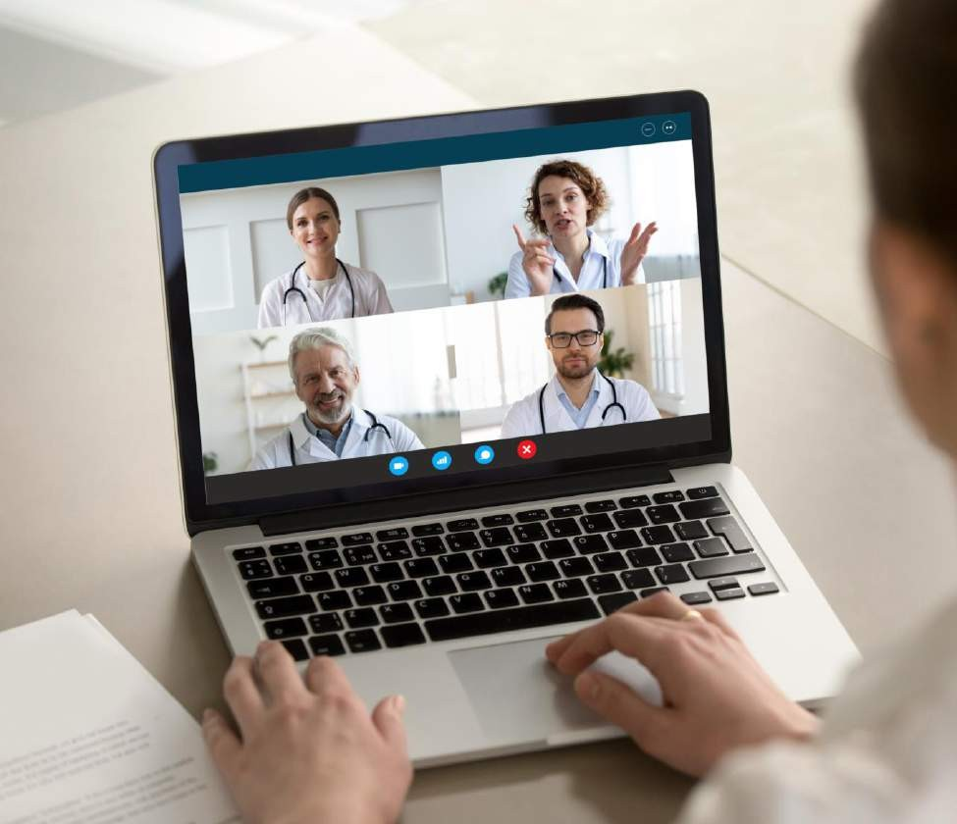
PRODUCT FUNCTIONS
Profile management by Admin.
Registration and login
Doctors
Patients
Maintenance of records

Slide 9
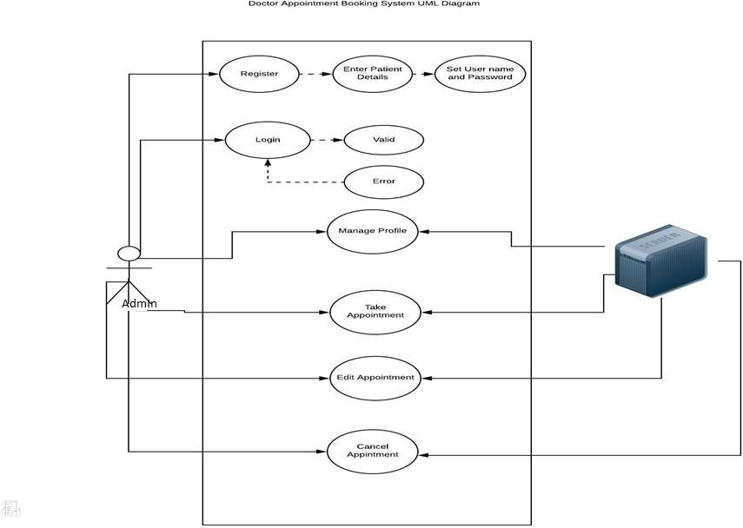
USE CASE DIAGRAM

Slide 10
ER DIAGRAM

Slide 11
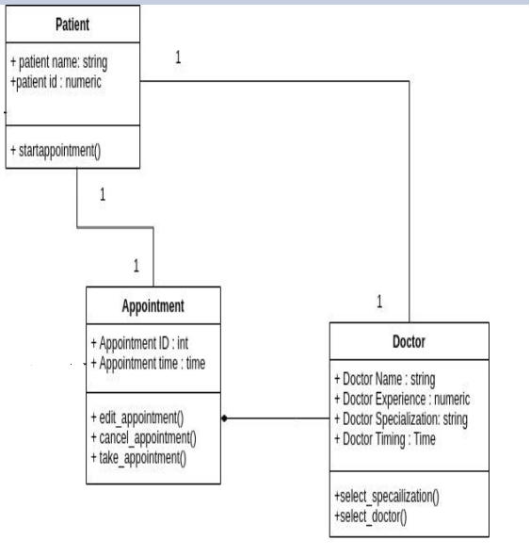
CLASS DIAGRAM

Slide 12
/JSP
ARCHITECTURE DIAGRAM

Slide 13
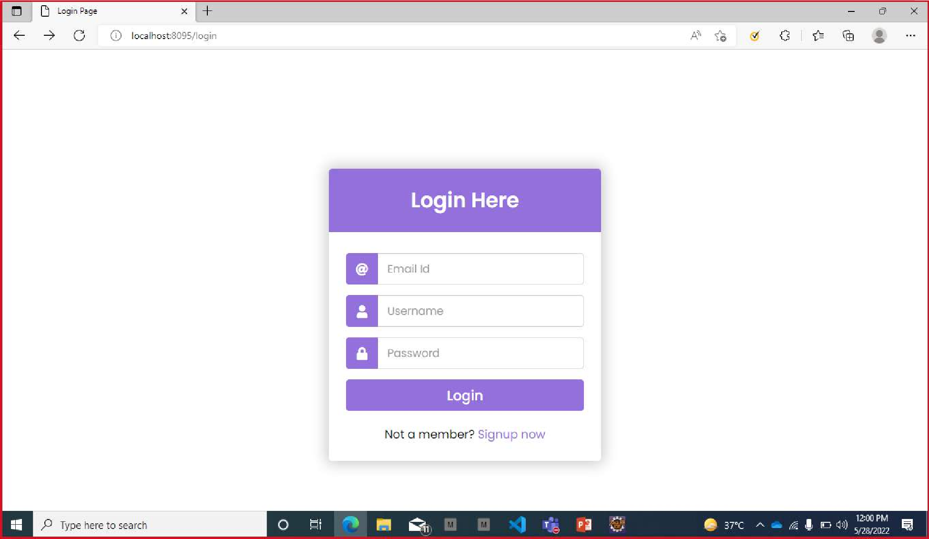

Slide 14
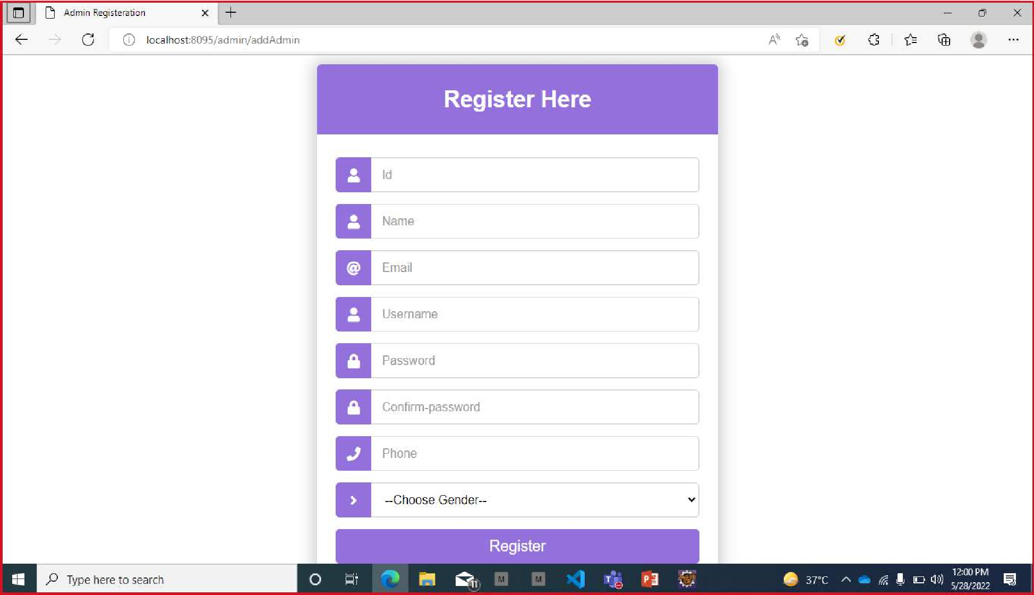

Slide 15
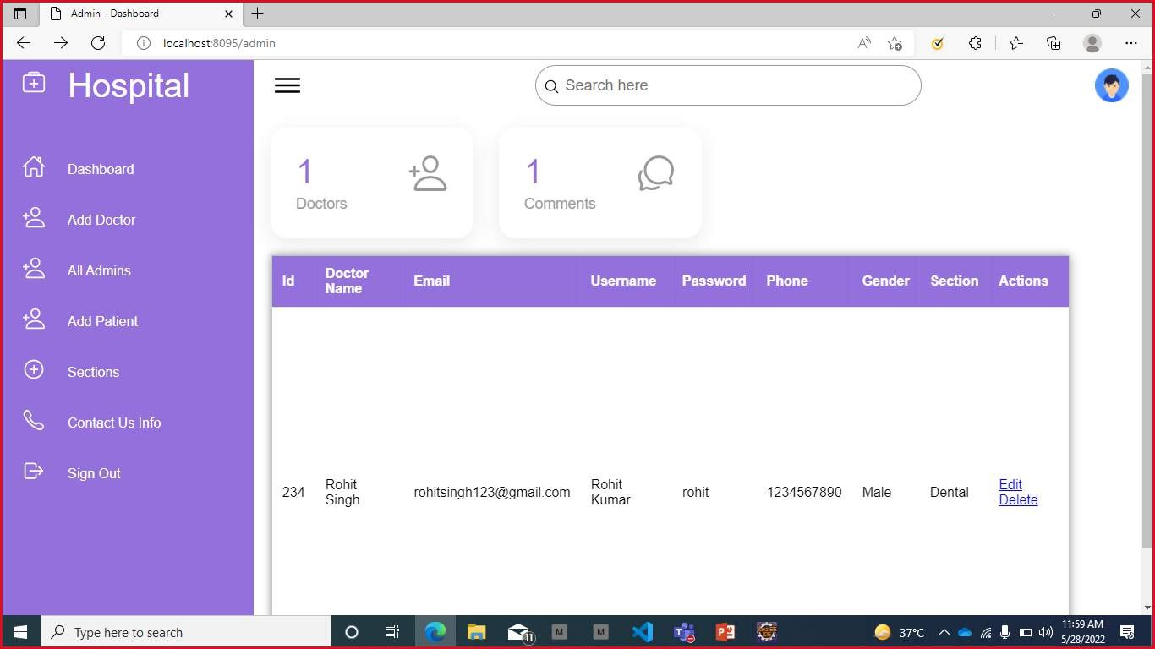

Slide 16
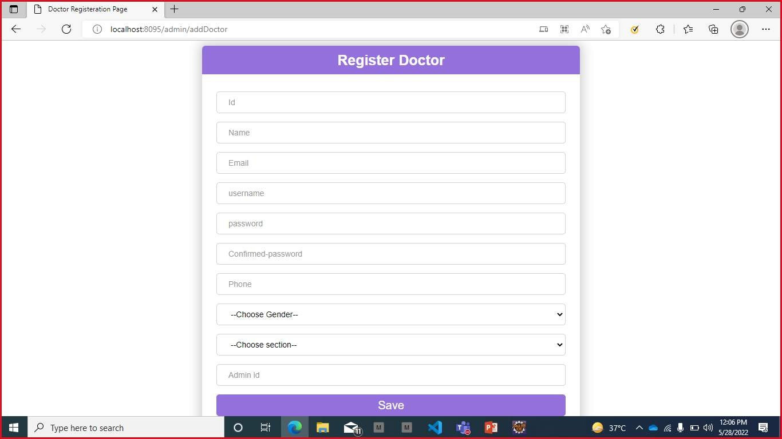

Slide 17
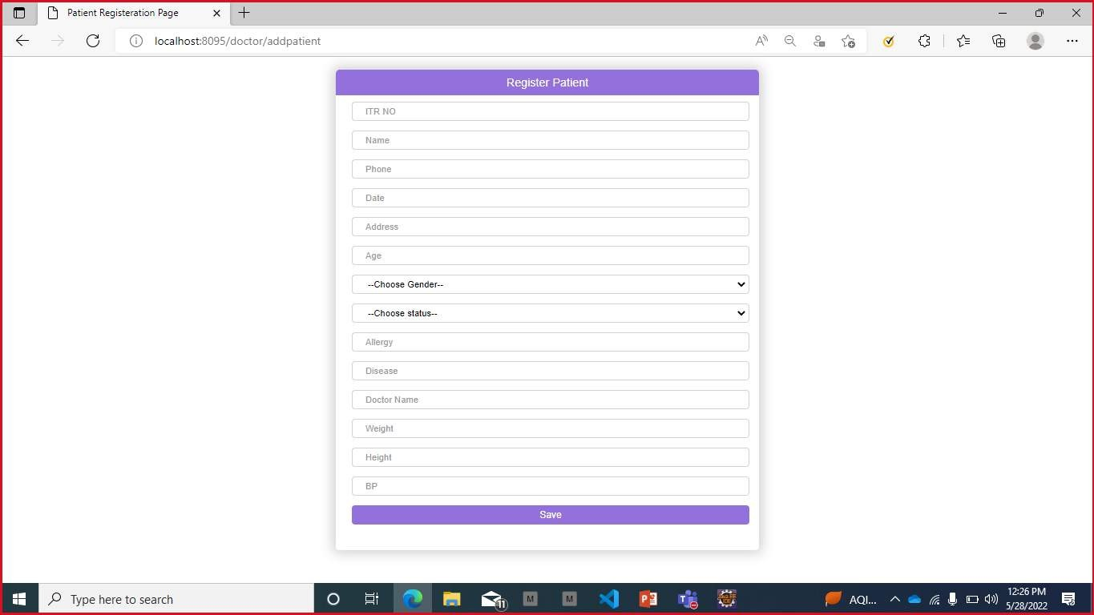

Slide 18
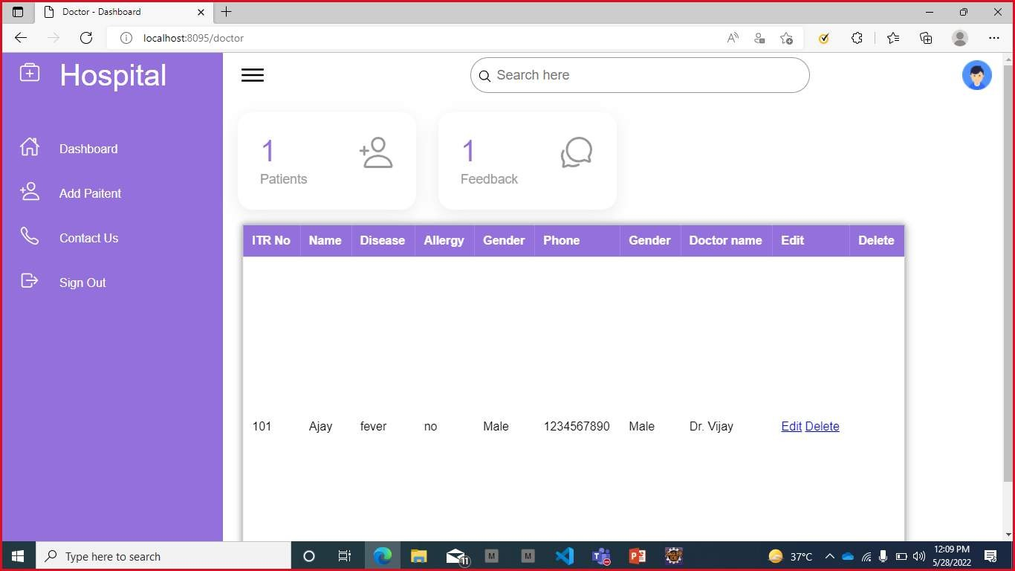

Slide 19





TOOLS AND TECHNOLOGIES
JDK1.8
Eclipse IDE
Apache Tomcat 9.0.54 HTML, CSS, Java Script, JSP Oracle 11g
Spring Boot
Spring Data JPA dependency

Slide 20

FEATURES
Multiple Locations and multiple doctors.
24*7 accessibility.
Access appointments on your computer and laptop.
Organize your schedule better.

Slide 21

Conclusion
Technology creates the way ahead for effective patient record management in the form of advanced hospital information system. From capturing, storing and disseminating records to reducing the risk of legal threat due to unmanaged medical records, hospital information system is instrumental at every stage.

Slide 22


